Slide 1

Mobile Application Development, Fall 2021 Using Outside APIs

Slide 2
Today’s Agenda
Today’s Plan / Setting up Axios
Making API Requests
Error Handling
One Last Gotcha Before Our First Search

Slide 3
Setting up Axios
Today we are going to be diving more deeply into using the Yelp API!
We’ve already spent time setting up our API key, and learning a little bit about what the data we’ll be getting from Yelp looks like.
So, ah, let’s get that data!

Slide 4
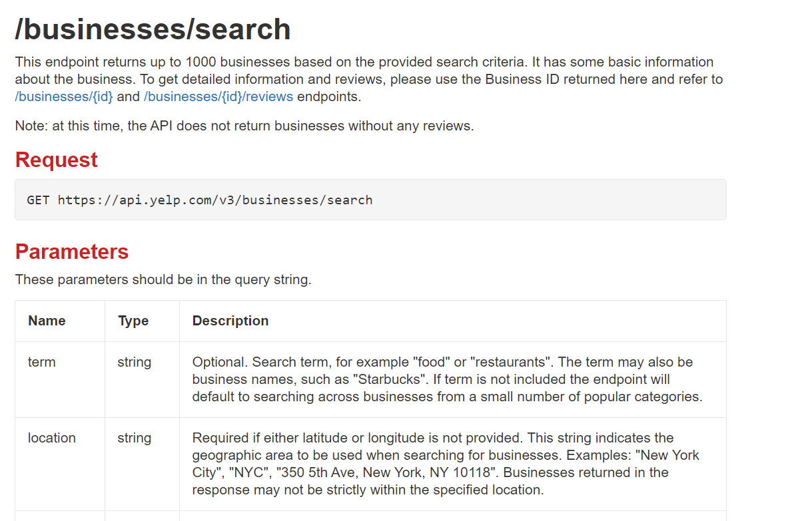

Setting up Axios
As we saw previously, we will ultimately be getting this data by making what are called requests.
Basically: Yelp gives us a URL to go to get the data that we want.

Slide 5
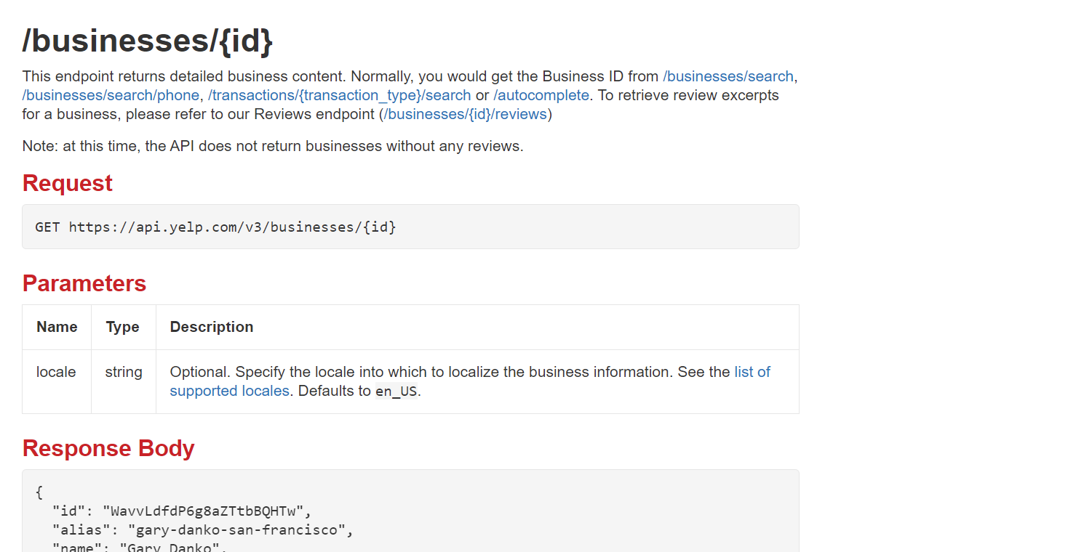


Setting up Axios
We saw that we’ll need data from two different endpoints, i.e., two different URLs, to make our complete app.

Slide 6
Setting up Axios
When using React Native, as it turns out, there are different ways to perform these network requests.
We’ll briefly chat about two right now:
fetch
axios

Slide 7
Setting up Axios
The default is fetch. It is just a built in function! We can just write fetch() inside of our code anywhere we want!
Pro: it is built in, we get it for free!
Con: Error handling is weird/strange/hard.
And you definitely will want to do error handling for network requests.
Con: You need to write a bunch of additional code to get it to work the way you want it to.

Slide 8
Setting up Axios
The other option is axios. This is a separate library that we’ll need to install.
Pro: Very easy to use! Definitely easier than fetch! Great defaults! Facilitates reusable code! Less total code written!
Con: Adding another dependency into our project.
Con: Makes our application size a little bigger (but only a teeny amount!)

Slide 9
Setting up Axios
As you might have guessed from the title of these slides, we’re going with axios for now!
The hassle part of this comes right at the beginning: we need to install it as a package.

Slide 10
Setting up Axios
Navigate to your project directory…
And type in:
npm install axios
Thankfully, it worked with minimal complaining (for me, hopefully for you too!)

Slide 11
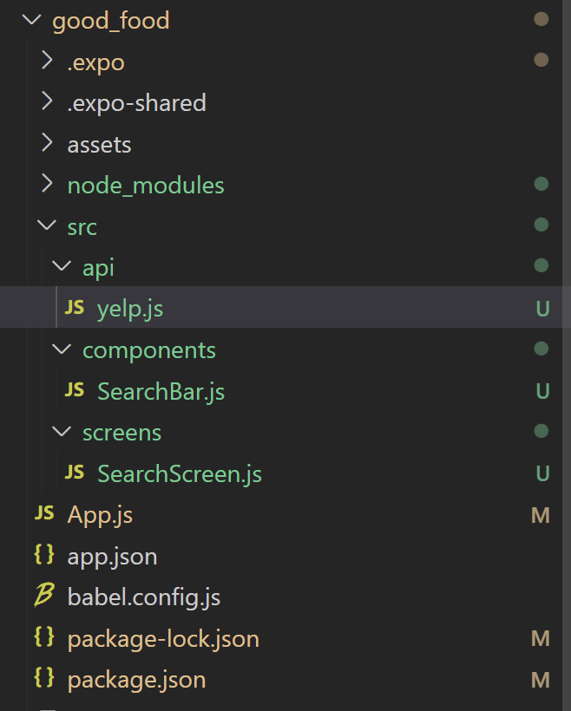
Setting up Axios
It’s a small package, so it should install pretty nicely!
Now – we’re going to create a new .js file in our project… and a brand new folder in our src directory!

Slide 12
Setting up Axios
Just as we have separate directories for screens and components…
We’ll make a folder called api…

Slide 13
Setting up Axios
As we’ll see in just a second, to configure axios to work with an api, you need to do some special set up.
It makes sense to do that set up in a separate file per API you are using.
Hence: Yelp.js
And it makes sense for all of those files to all live in the same folder.

Slide 14
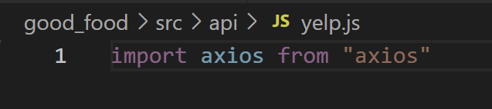
Setting up Axios
Inside of yelp.js (and indeed, any of these api config files) we’ll need to:
Create a new instance of axios
Configure it with specifics needed for the API we want that instance to make requests to.
We can start that by simply importing axios with:
import axios from “axios”

Slide 15
Setting up Axios
And remember, the idea is that we are going to create an axios instance.
That instance will connected to a specific API
Such as Yelp
And then we’ll export that instance, so that we can use it in other parts of our code.

Slide 16
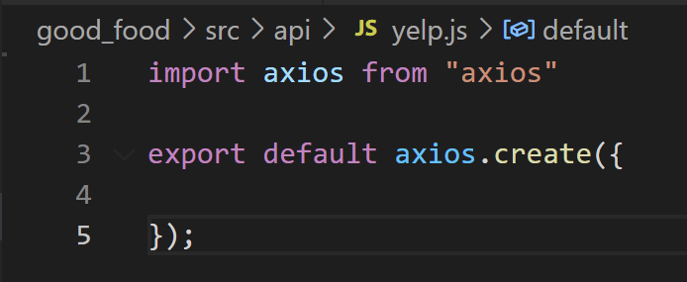
Setting up Axios
That’s what’s going on with lines 3-5.
The axios.create({}); part is essentially invoking an axios constructor, i.e., it will create and return an axios instance.
And the export default part, as we’ve seen, will then enable that instance to be used throughout our code.

Slide 17
Setting up Axios
Of course, we’ll need to specifically make this axios instance connected to Yelp.
We’ll do that by adding properties to that object!

Slide 18
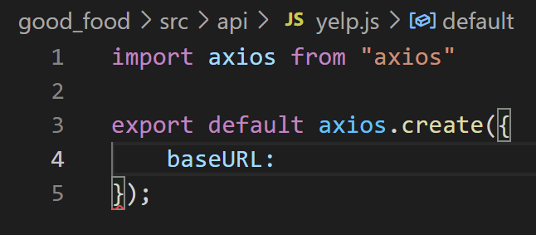
Setting up Axios
The first property is ‘baseURL’
You want this to be a URL that can be used by all of the API’s endpoints that you are interested in.

Slide 19
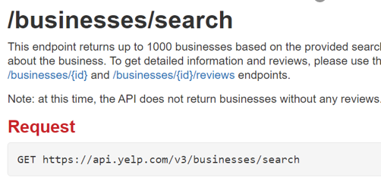
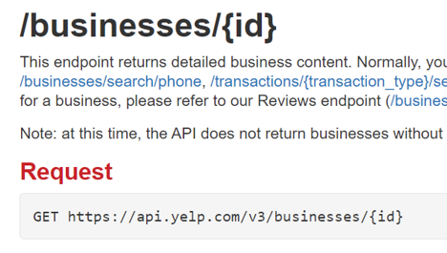
Setting up Axios
For us, we care about these two endpoints.
And you can see that the parts that they have in common are
https://api.yelp.com/v3/businesses

Slide 20
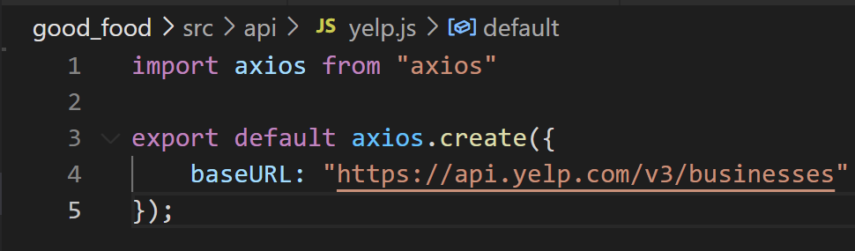
Setting up Axios
And so we can add that here.!
NOTE that we do NOT have a final “forward slash” ( / ) at the end of the URL.
It just ends with the word businesses. That’s how it works.

Slide 21
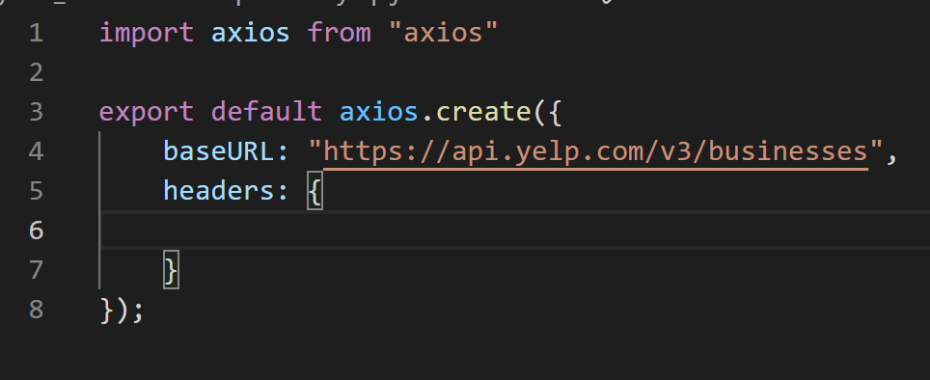
Setting up Axios
This is also where we will finally make use of the API key we got.
In order to authorize ourselves with Yelp, we need to send a request header.
We can do that with this axios instance as well.

Slide 22
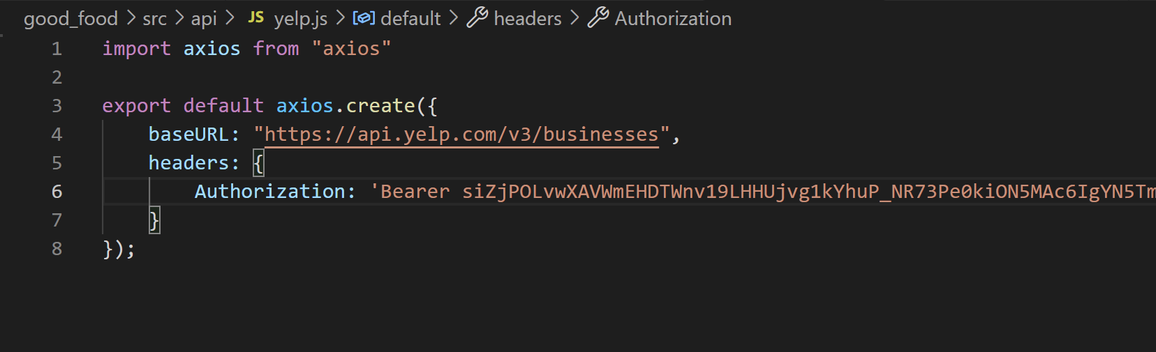
Setting up Axios
Inside of this headers object, we make a new property called Authorization
With an upper case A – that’s very important!
And then the value is a String which is…
First, the word Bearer (with an upper case B)
Then a space
Then your API key.
The idea is basically saying “we are the bearer of this key, let us in!”

Slide 23
Setting up Axios
And there you go!
We now have an axios instance that is going to be able to send authorized requests to Yelp!
Now, let’s use it!

Slide 24
Today’s Agenda
Today’s Plan / Setting up Axios
Making API Requests
Error Handling
One Last Gotcha Before Our First Search

Slide 25
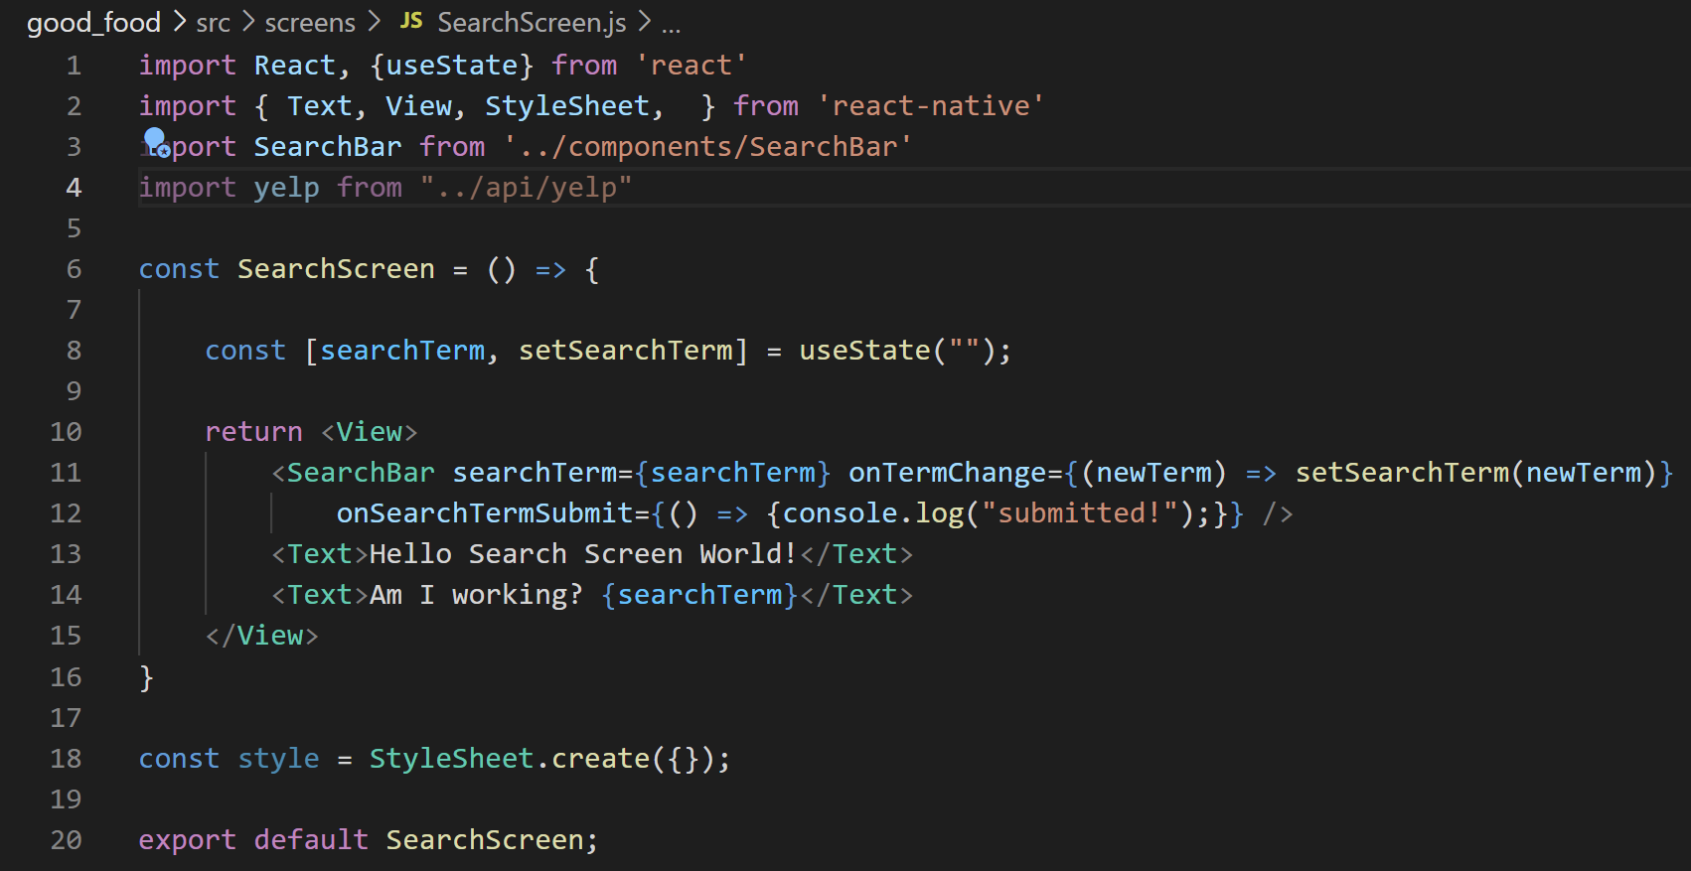
Making API Requests
We want to be making these request on the ‘top level’ of our app, so here, SearchScreen.js.
And to do so, we’ll need to import that axios instance we just exported!

Slide 26
Making API Requests
So by this point, I hope it’s clear, but the current goals are:
1.) How can we use this axios instance to make our request?
2.) How can we make use of the response to update our app with appropriate restaurants?

Slide 27
Making API Requests
Although the exact syntax for achieving this isn’t known to us yet…
I’m hoping that your brains are thinking “ah! We probably need to make use of state!
Because the results will be different as we make different requests, and as those results change we’ll want to re-render the screen.

Slide 28
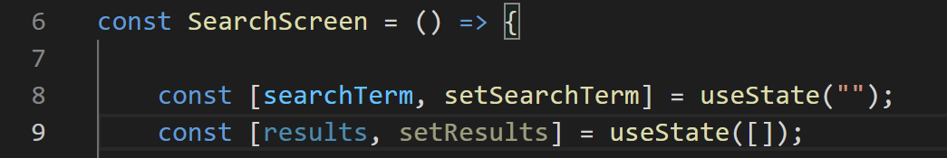
Making API Requests
So here is a possibility!
We make use of our good friend the useState hook.

Slide 29
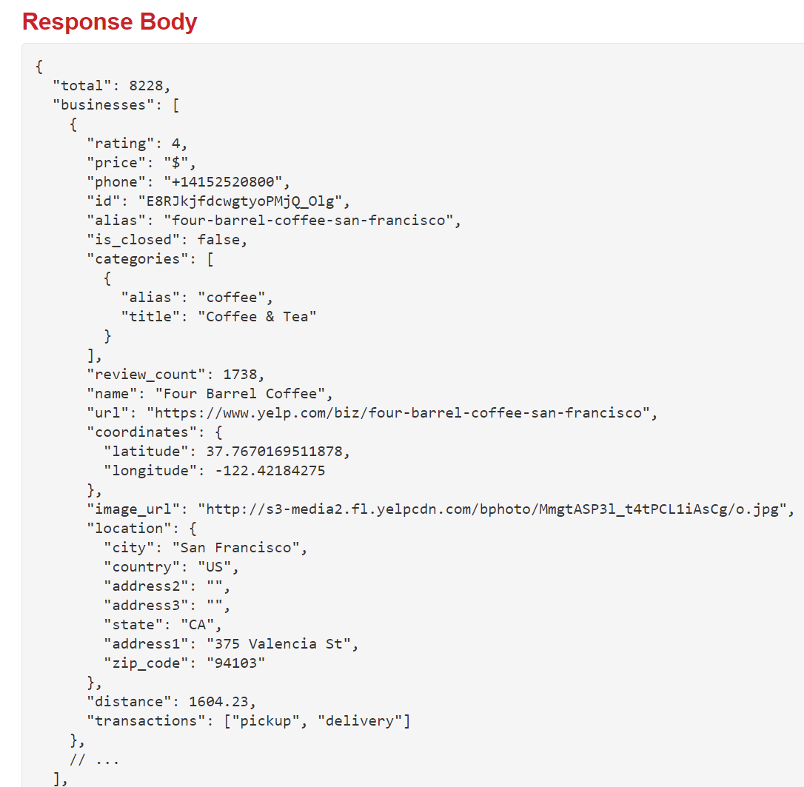

Making API Requests
Note that we are giving it a default value of an empty array.
This is because, based on the documentation, we expect to get a big array, with each element being a different restaurant.

Slide 30
Making API Requests
OK. Cool!
So, just as a first step: let’s make it so that it prints out the total number of results it fetched!
Note: we still aren’t actually using it yet.

Slide 31
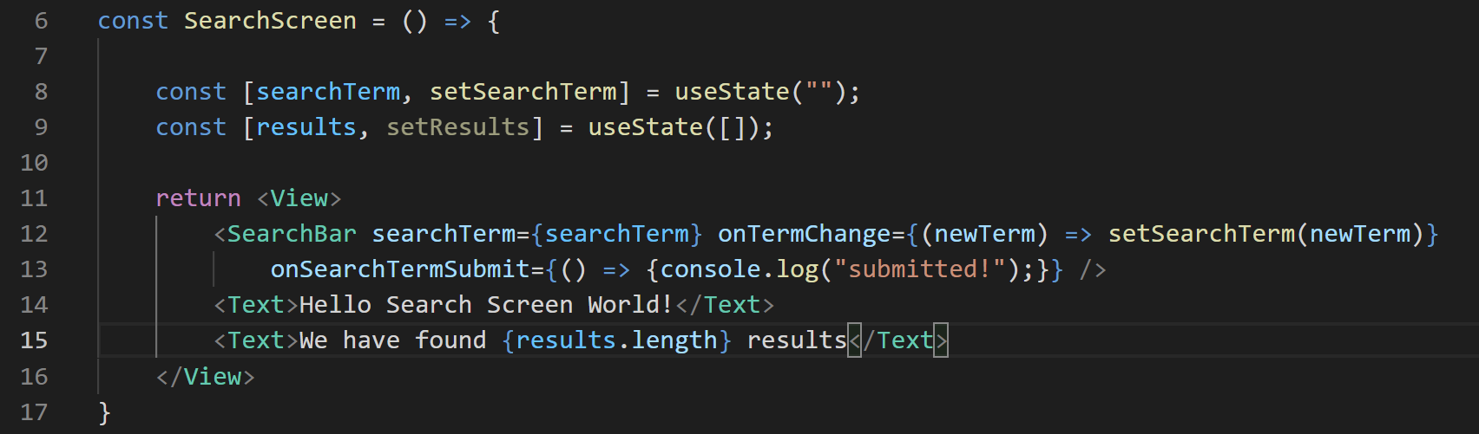
Making API Requests
But just to set it up for future testing…
We can say this new line right here…
When that number is non-zero, then we will know that we will have successfully found some results!

Slide 32
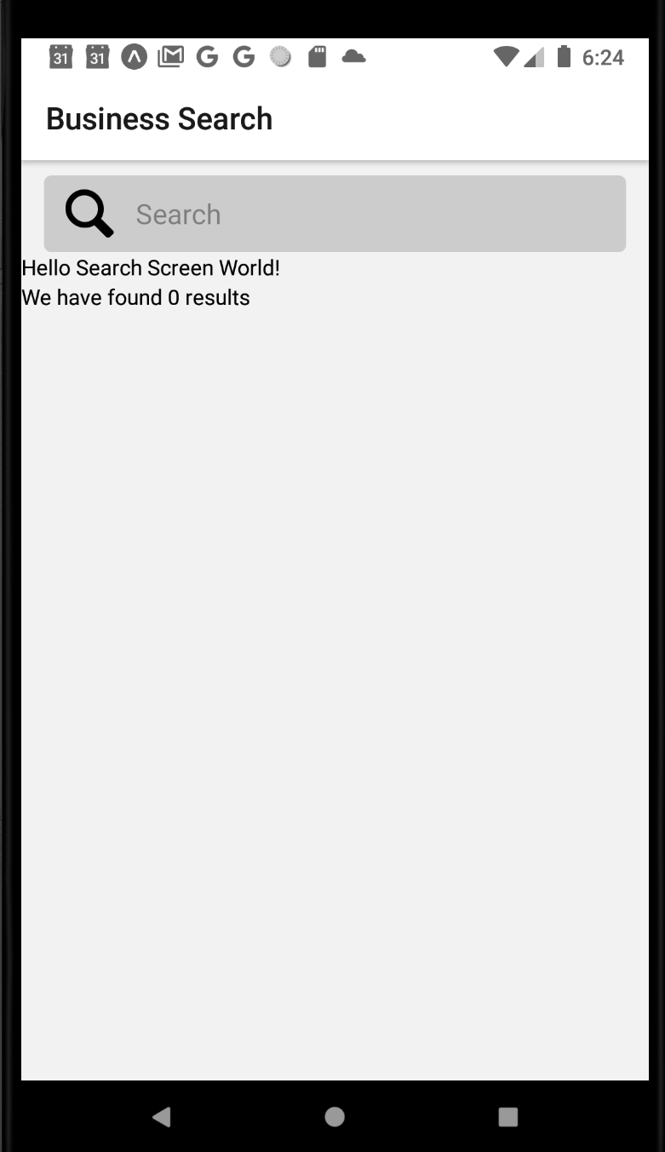
Making API Requests
But as is expected, we’re not there yet!
We haven’t actually made the request yet!
But let’s do that now!

Slide 33
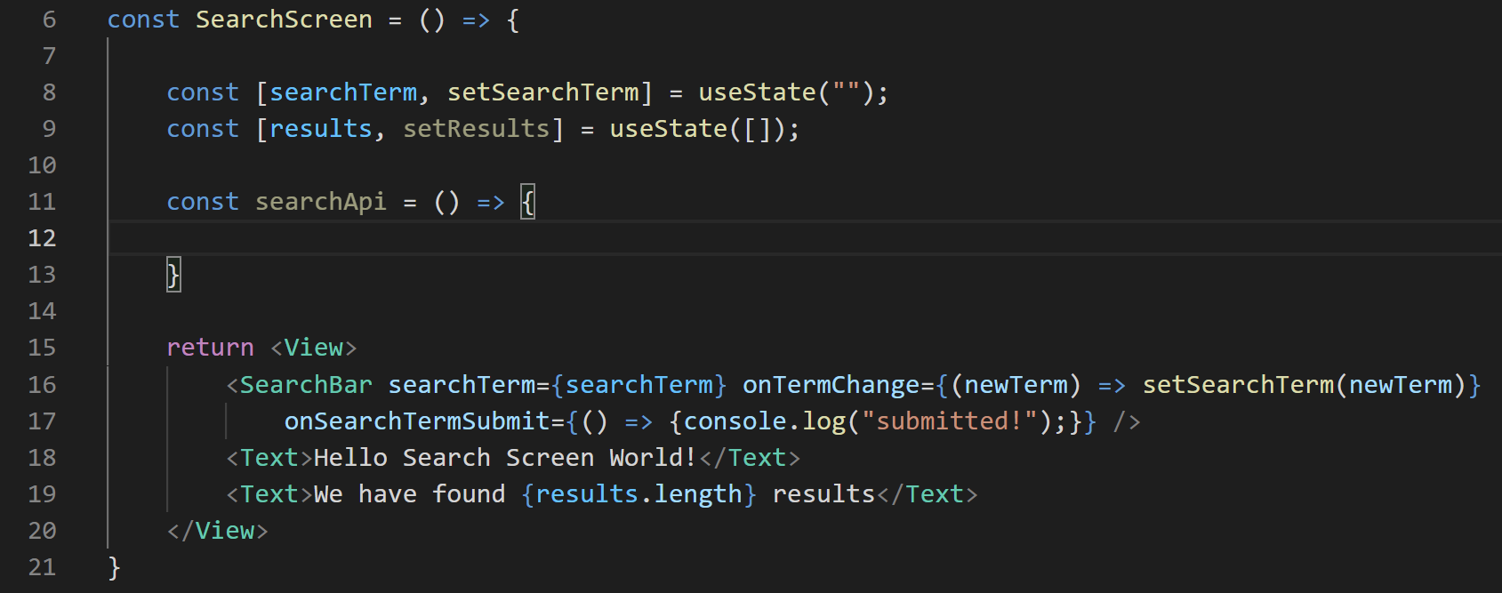
Making API Requests
We’ll make a little helper function inside of our component.
We’ll call it searchApi

Slide 34
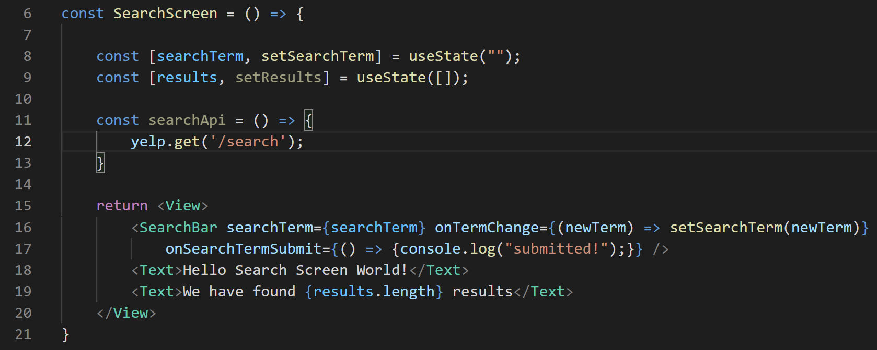
Making API Requests
And we’ll have it’s body simply be the following:
yelp.get(‘/search’);

Slide 35
Making API Requests
get here, is a function, specifying the type of http request we are making.
Here a get request
Which you might recall is what the Yelp API documentation said it wanted.

Slide 36
Making API Requests
And the argument ‘/search’ here is what is going to get appended on to what we set for baseURL in our yelp.js file.
A ‘route’ name if you will.

Slide 37
Making API Requests
yelp.js
SearchScreen.js
So, the baseURL is: https://api.yelp.com/v3/businesses
And then we append to that: “/search”
Getting us the final URL:
https://api.yelp.com/v3/businesses/search
Which was, in fact, one of our the Yelp API’s endpoints.

Slide 38
Making API Requests
SearchScreen.js
Now, here is a big thing…
Making an API call like this is an asynchronous operation.
It takes time to make a network request!
So instead of having your app just hang forever until the data comes back…
Your app will just “keep on going” while the data is fetched in the background.

Slide 39
Making API Requests
SearchScreen.js
That’s good! Hanging is bad!
HOWEVER – it adds a new question. How do you know when your asynchronous thing is done?
When are you allowed to start using the data from the response?
How do you use the data from the response?

Slide 40
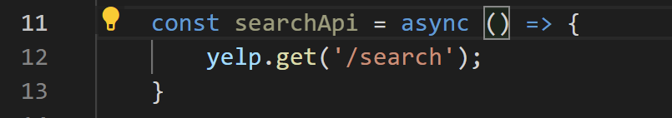
Making API Requests
SearchScreen.js
Well, JavaScript has a few ways that you can do it.
The way that we’ll do it is by making searchApi an asynchronous function.
We do that with the use of the async keyword.

Slide 41
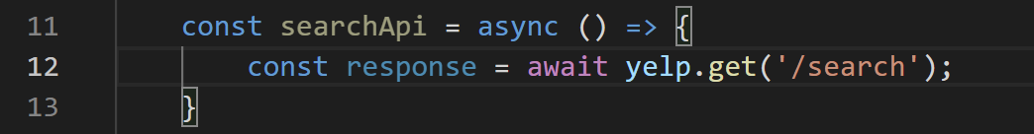
Making API Requests
SearchScreen.js
By marking this function as async, we are now allowed to use the await keyword inside of it.
NORMALLY: when you see assignment, you just take the thing on the right and store it in the thing on the left.
BUT BECAUSE yelp.get is asynchronous and we don’t know how long it will take…
await basically says: let yelp.get take as long as it needs.
When yelp.get is all done, THEN continue on as normal.
i.e., here, take whatever yelp.get returned and store it inside of response.

Slide 42
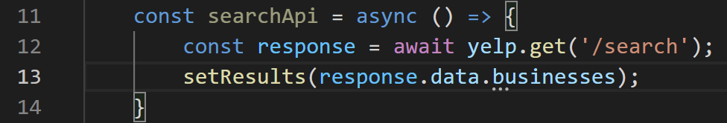
Making API Requests
SearchScreen.js
And you’ll need to take my word for it that what yelp.get will return, and thus what response will ultimately hold, is a big ol’ object.
That object will have a property called data, that represents EVERYTHING that got returned.

Slide 43

Making API Requests
SearchScreen.js
That is, response.data would be ALL of this.

Slide 44

Making API Requests
SearchScreen.js
But there are parts of that object we don’t care about!
For example, we don’t really care about storing “total”
All we really care about is this array of businesses.

Slide 45

Making API Requests
SearchScreen.js
Now, this is looking pretty good!
BUT! Don’t forget!
We also discussed how we can pass in different parameters to customize the search.
e.g., narrow searches based on terms, location information, etc.

Slide 46
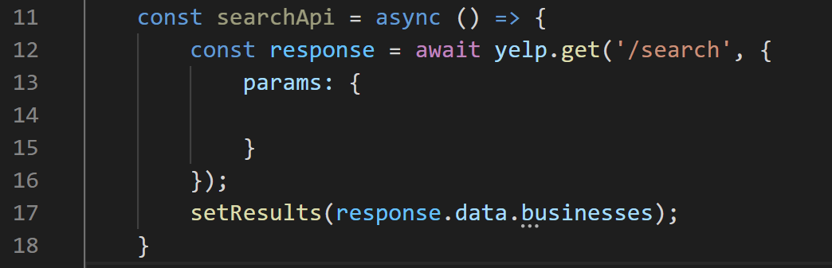
Making API Requests
This is another situation where axios makes our lives easier!
We will pass in a second argument to the function: an object.
SearchScreen.js

Slide 47
Making API Requests
And give that object a params property, whose value is an object itself.
SearchScreen.js

Slide 48
Making API Requests
Any key value pairs we put into this will automatically be appended to our request url.
Which is how you specify those parameters to the API.
SearchScreen.js

Slide 49
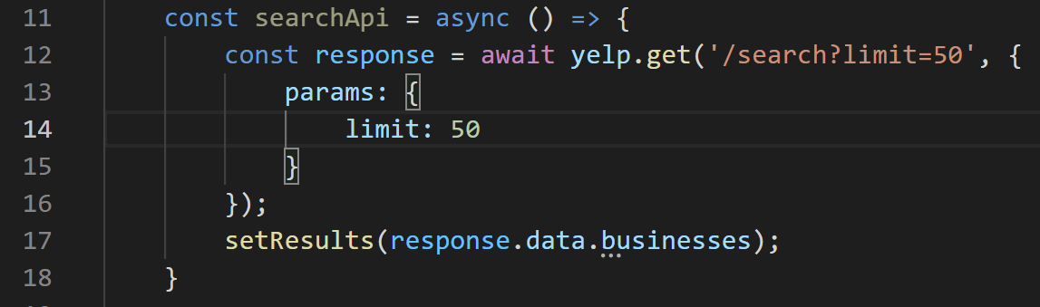
Making API Requests
Just to give you a taste of what it WOULD like…
If we specified a parameter of limit with a value of 50,
our url would look like “…/search?limit=50”
SearchScreen.js

Slide 50


Making API Requests
SearchScreen.js
That’s what this line here meant.
About the parameters being in the “query string”
And again, all of the parameters we have available to us are right here.

Slide 51
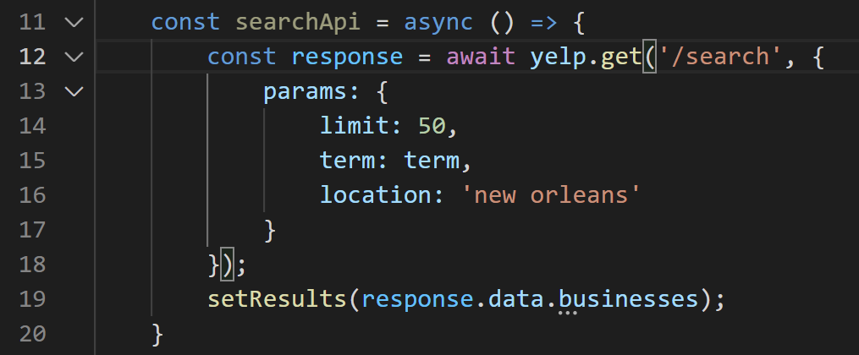
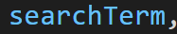
Making API Requests
SearchScreen.js
Let’s get rid of that query string
Remember: axios will add it for us!
Let’s set the ‘term’ parameter to be our piece of state called searchTerm
And let’s hard code a location, so in theory we should only get new orleans businesses.

Slide 52
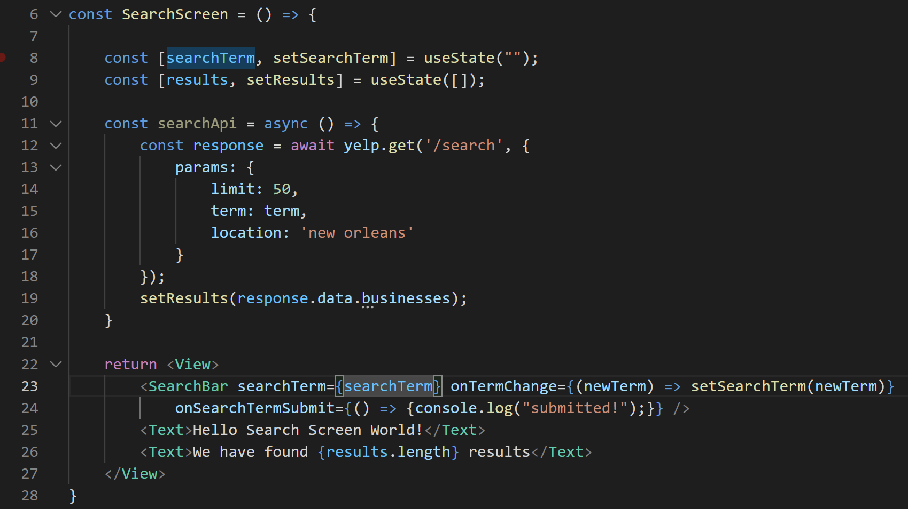
Making API Requests
At this point there’s only one silly thing left! Can you spot it?
SearchScreen.js

Slide 53
Making API Requests
SearchScreen.js
We wrote this lovely helper function, but we still aren’t calling it yet!
Let’s have it be invoked whenever we submit a search term, yeah?

Slide 54
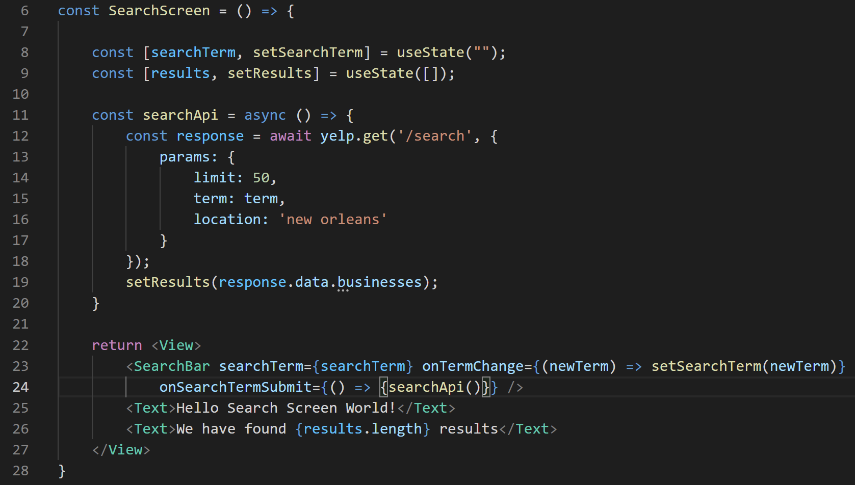
Making API Requests
SearchScreen.js
So we’ll need to do something like this

Slide 55
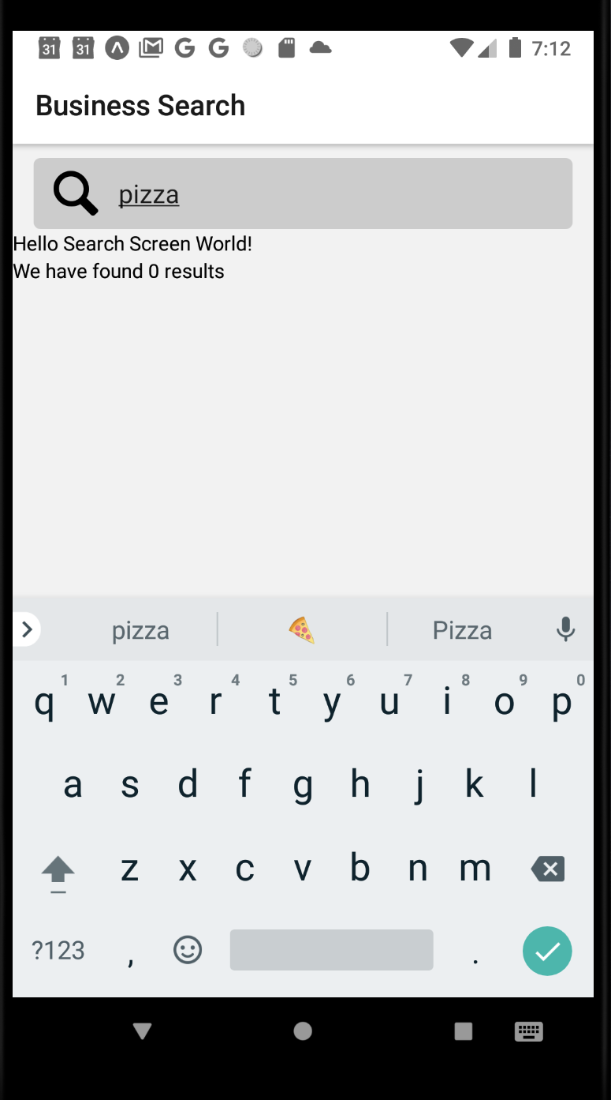
Making API Requests
And with that…
If you go back to your app, and type something in…
And then hit ‘enter’ or the checkmark or whatever…

Slide 56
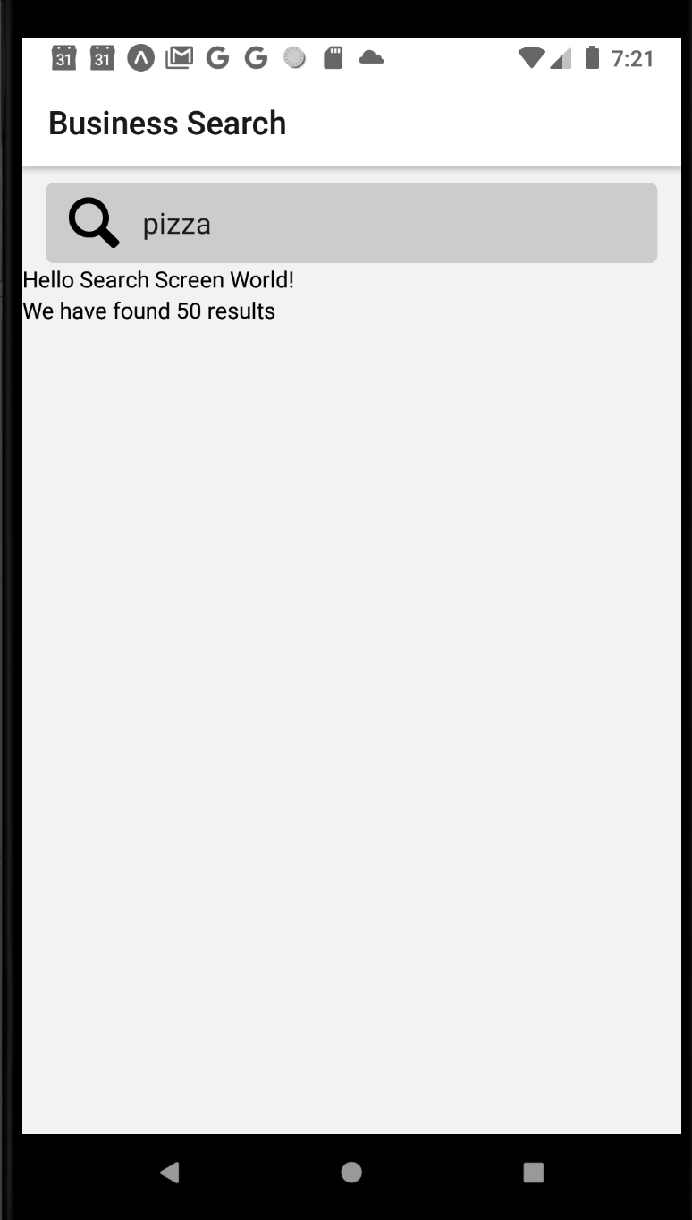
Making API Requests
And you should see this!
The number 50!
It found 50 New Orleans pizza places!

Slide 57
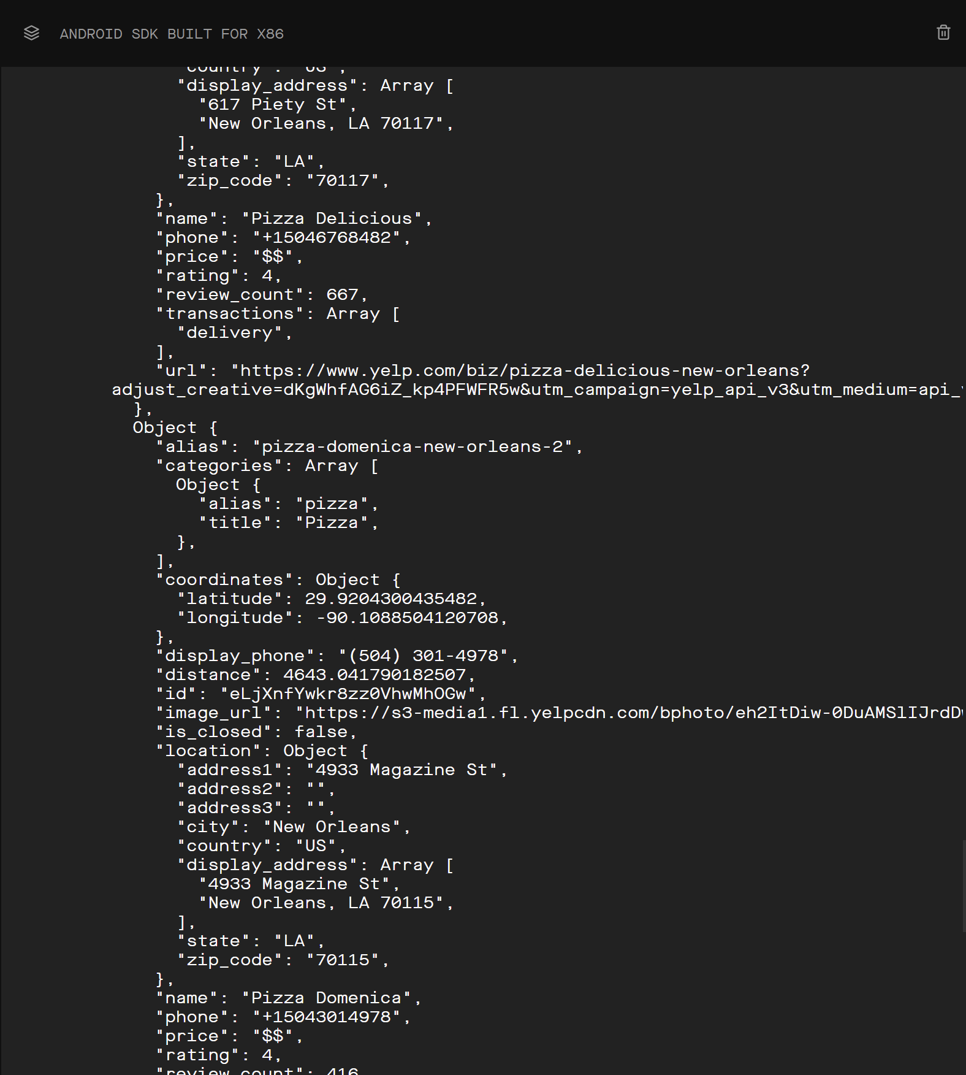


Making API Requests
If you were to add a console.log to it…
You’d see something like this!
Look at that!
Our phone is smart enough to know about Pizza Delicious!
And Pizza Domenica!

Slide 58
Making API Requests
That is… assuming that you don’t have any typos.
You might get some very unhelpful warning messages about “promises” not being kept.
That might mean that…
You have a typo in one of your parameters in yelp.js or your axios call…
You didn’t copy your API key correctly…
Or didn’t include the word “Bearer” with a space.
You must be extra diligent with this, as it is very picky.

Slide 59
Today’s Agenda
Today’s Plan / Setting up Axios
Making API Requests
Error Handling
One Last Gotcha Before Our First Search

Slide 60
Error Handling
We’ve come a long way!
But we’ve got a ways to go!

Slide 61
Error Handling
I know the temptation is to just start using this sweet data *right now.*
BUT!
Remember, we’re developing for a mobile device. Our users might have a poor signal!
And if they do, it means requests like this can fail.

Slide 62
Error Handling
So, a good habit to get into: any time we work with network requests…
Which we are doing right now!
We should really plan on weaving in a little bit of error handling.
And to make sure the user knows if something went wrong.
i.e., to report our error handling in a user friendly way.

Slide 63
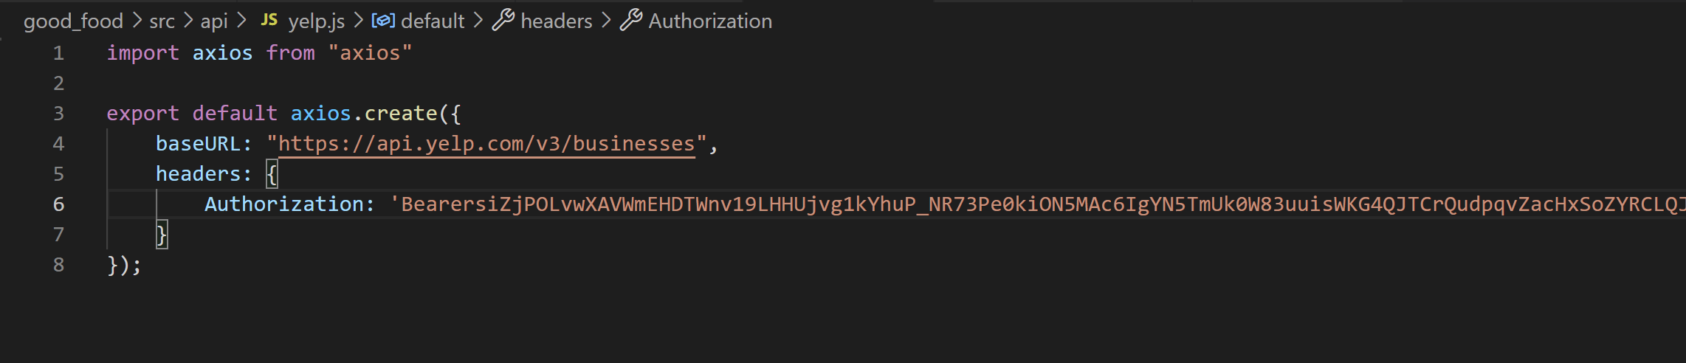
Error Handling
To debug / develop this, we can intentionally introduce an error!
Misspell a parameter name!
Get your API key slightly wrong, for example, remove the space after bearer!

Slide 64
Error Handling
If you do that you should get an error message.
One thing to note: WE can see that during development, but during deployment, it wouldn’t show up.
So from the user’s perspective, the phone would just be unresponsive.
So let’s fix it!

Slide 65
Error Handling
Now, just out of curiosity, before we dive into that…
Does any “classic” solution jump out at you?
What have you done in the past when you’ve written code that might fail or produce errors?

Slide 66
Error Handling
Now, just out of curiosity, before we dive into that…
Does any “classic” solution jump out at you?
What have you done in the past when you’ve written code that might fail or produce errors?

Slide 67
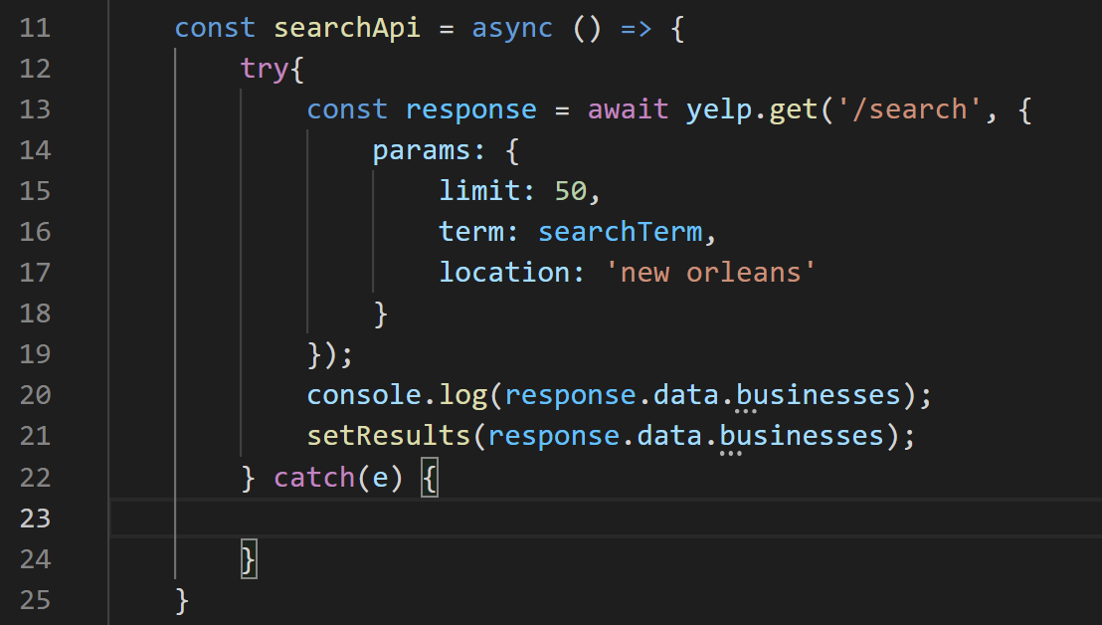
Error Handling
Maybe you’ve used try-catch blocks before, yeah?
You wrap the “dangerous” code that might fail in the try…
And then if an error does happen, the code in the catch block executes!

Slide 68
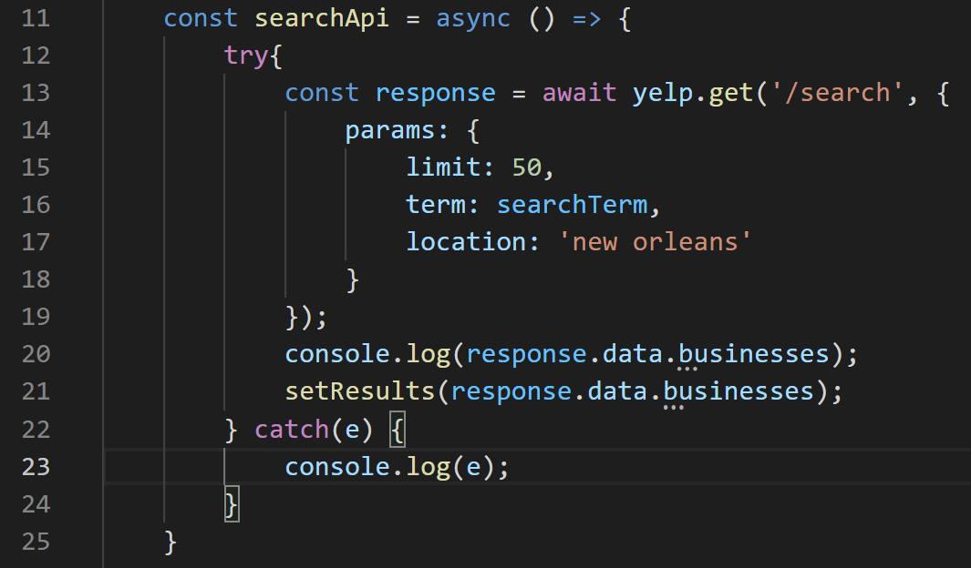
Error Handling
That ‘e’ is going to be an error object, with plenty of properties explaining the nature of the error that occurred if we find ourselves in the catch block.
We can print it out with a console log line.

Slide 69
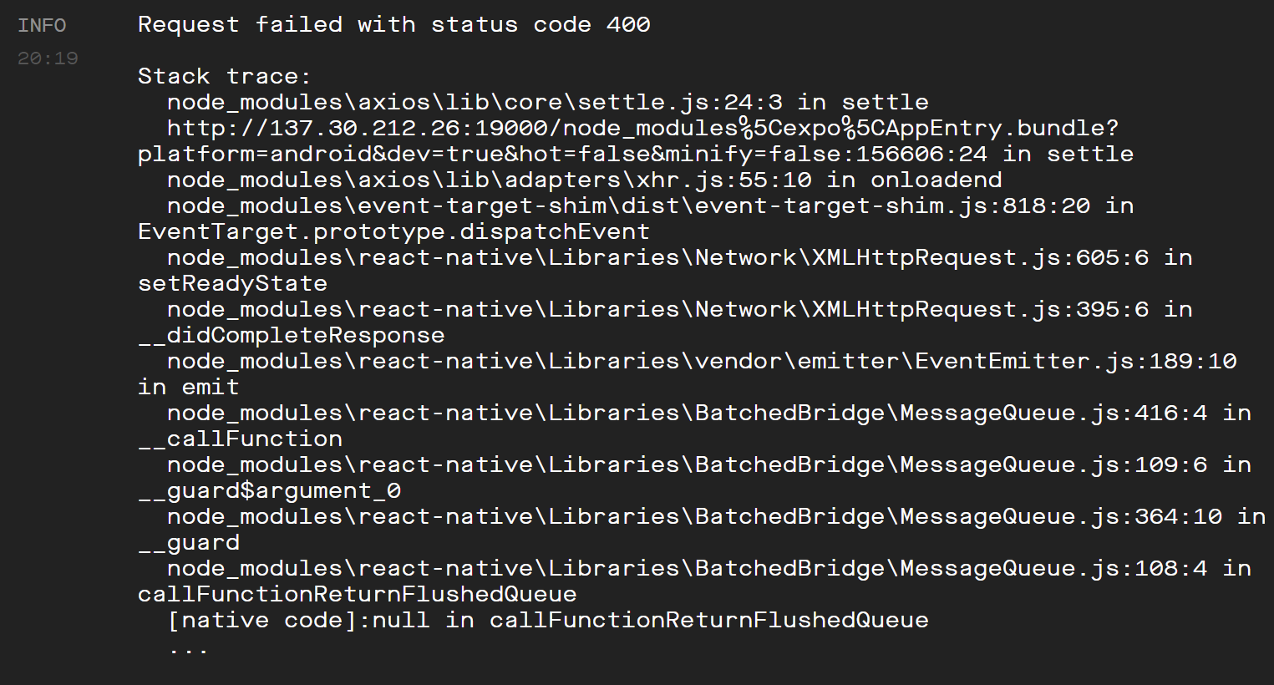
Error Handling
At this point, our app won’t make an error message appear.
Because it was successfully caught!
BUT
It *will* print out all of these charming lines on the console. This is that error message!

Slide 70
Error Handling
SO. If we wanted, we could try to figure out what this is trying to tell us…
And then give the user a very specific message based on that.
But they probably don’t want to see all this junk.
You probably don’t either.

Slide 71
Error Handling
So instead, we’ll just print out a more generic, but perhaps more user friendly, message of “oops! Something went wrong!”
Regardless: if we are updating the screen, we’ll need a new piece of state with which to do it.

Slide 72
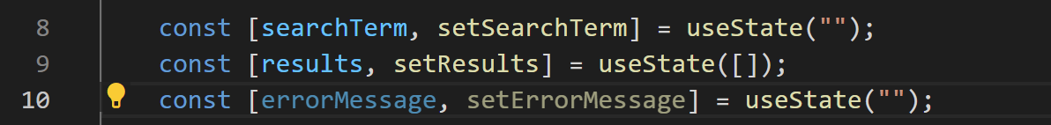
Error Handling
So, we can add a third state variable to represent the current error message.
And we can set its default value to the empty string.

Slide 73
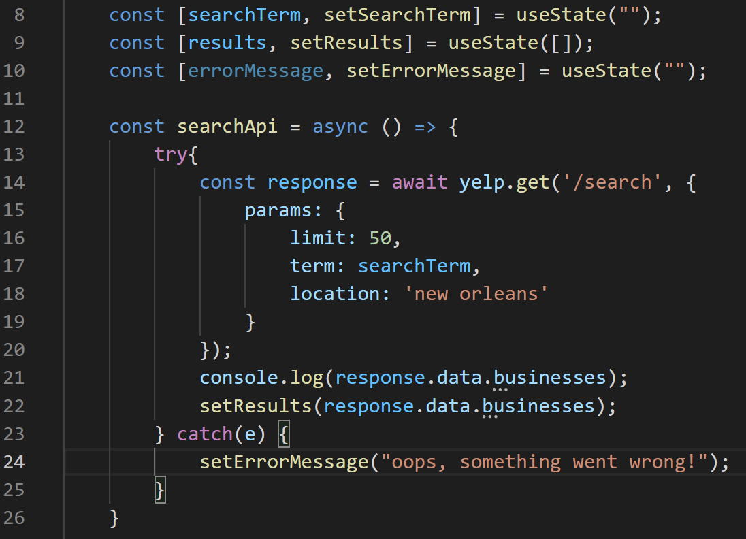
Error Handling
And then we will use the setter for that state variable inside of our catch block.
And then we can print out the value of errorMessage inside of our JSX!

Slide 74
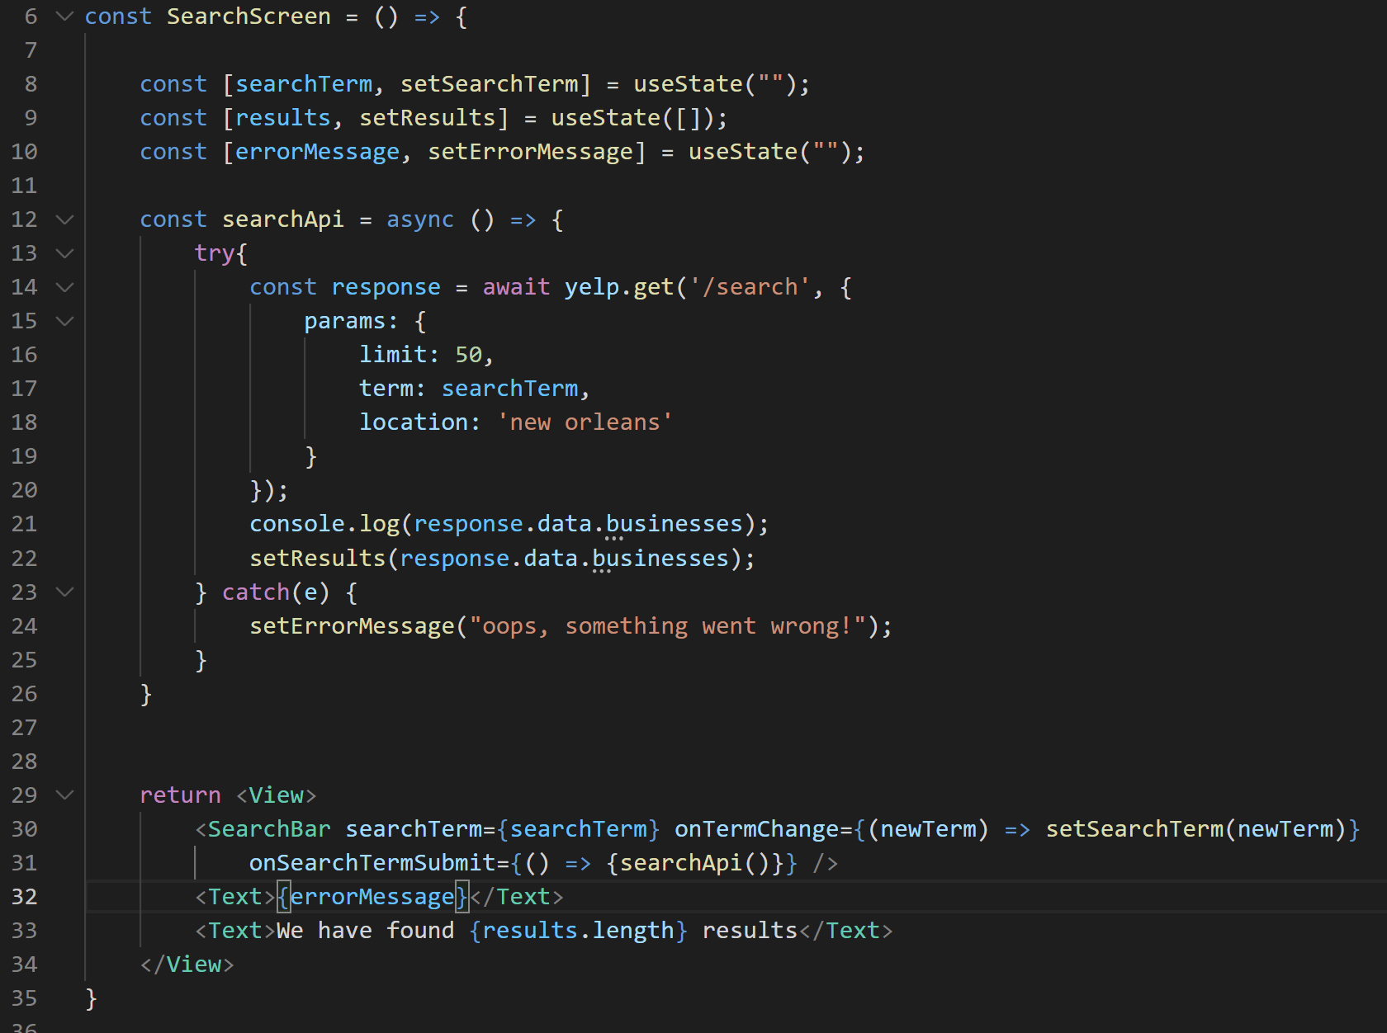
Error Handling
Here’s us doing that here!
We can revisit this to make it look prettier in a moment…

Slide 75
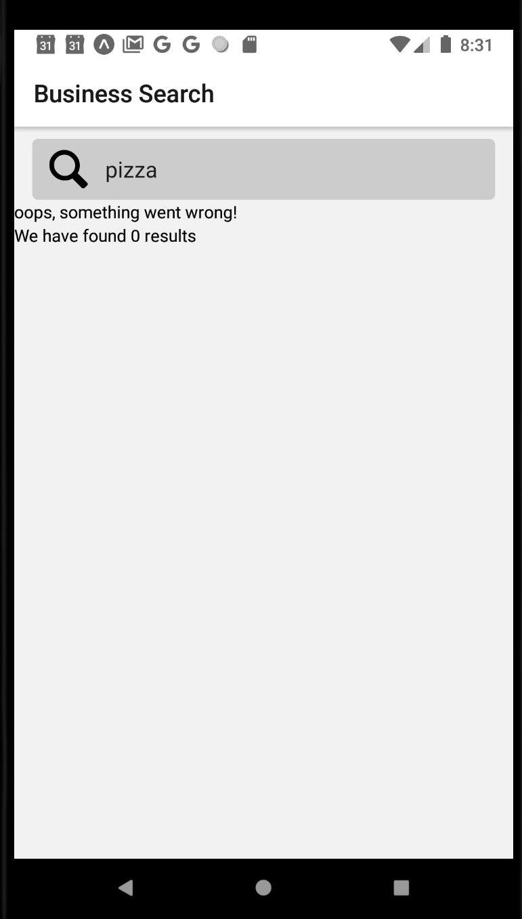
Error Handling
But now the app shows the error message!
If the string is empty, it’ll just show an empty string!
And if the string has a message, it’ll show the message!

Slide 76
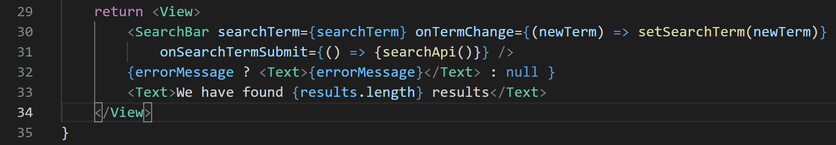
Error Handling
And to make it look even cleaner, we can wrap it in the ternary operator.
Don’t forget to wrap the ternary operator in those { and } braces!
So now, if errorMessage has *something* inside of it, render the text element.
Otherwise, don’t do anything.

Slide 77
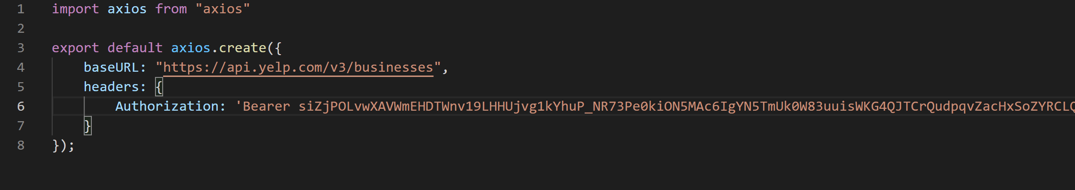
Error Handling
OK – that’s a good amount of error handling for now!
Let’s add that space back in, so that we don’t have errors anymore.
And now… let’s move on!

Slide 78
Today’s Agenda
Today’s Plan / Setting up Axios
Making API Requests
Error Handling
One Last Gotcha Before Our First Search

Slide 79
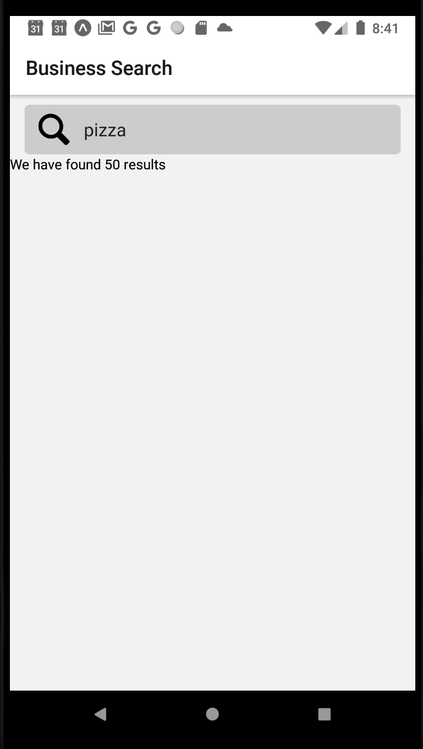
A First Search
So, at present… when the screen first loads, there is *no* data, right?
It isn’t until the user types their first search that we get stuff back, yeah?
But… like… is that actually what we want?

Slide 80
A First Search
In most apps that you use, even apps that depend on the user searching for things, there is probably quite a lot of “initial” data displayed.
It would be nice if ours did that too!
If, as soon as our app started up, it automatically made a temporary search to the Yelp API.

Slide 81
A First Search
This is going to be another one of those cases where we are going to *start* with the “intuitive” way.
And then will discover that the “intuitive” way ends up having some problems.
And then discuss alternatives.

Slide 82
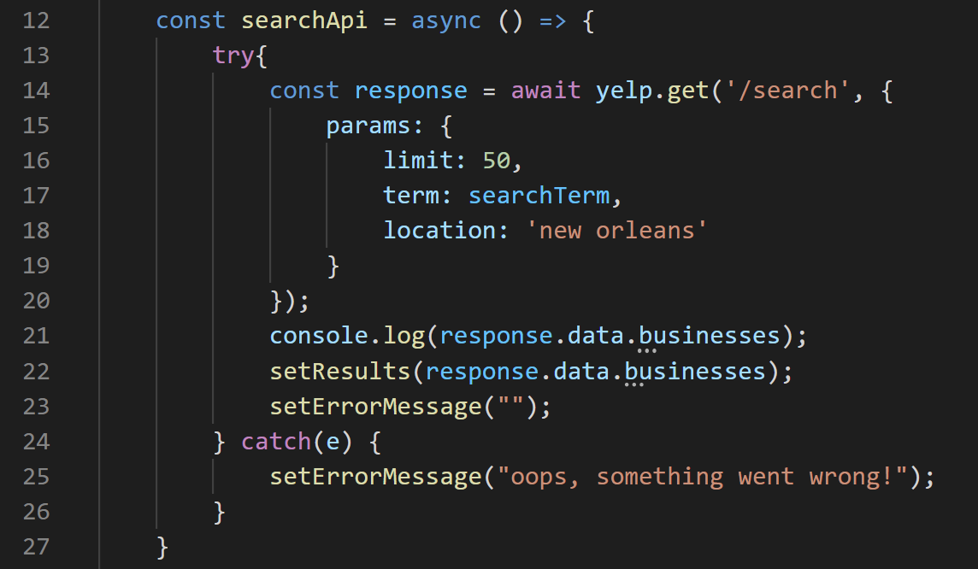
A First Search
So, here is our little searchApi function.
We call this to get data.
If we want data at the start of the app, it makes sense to call this at the start of the app.
But do you see a problem with that?

Slide 83
A First Search
It depends on the value of searchTerm.
Whose default value is the empty string!

Slide 84
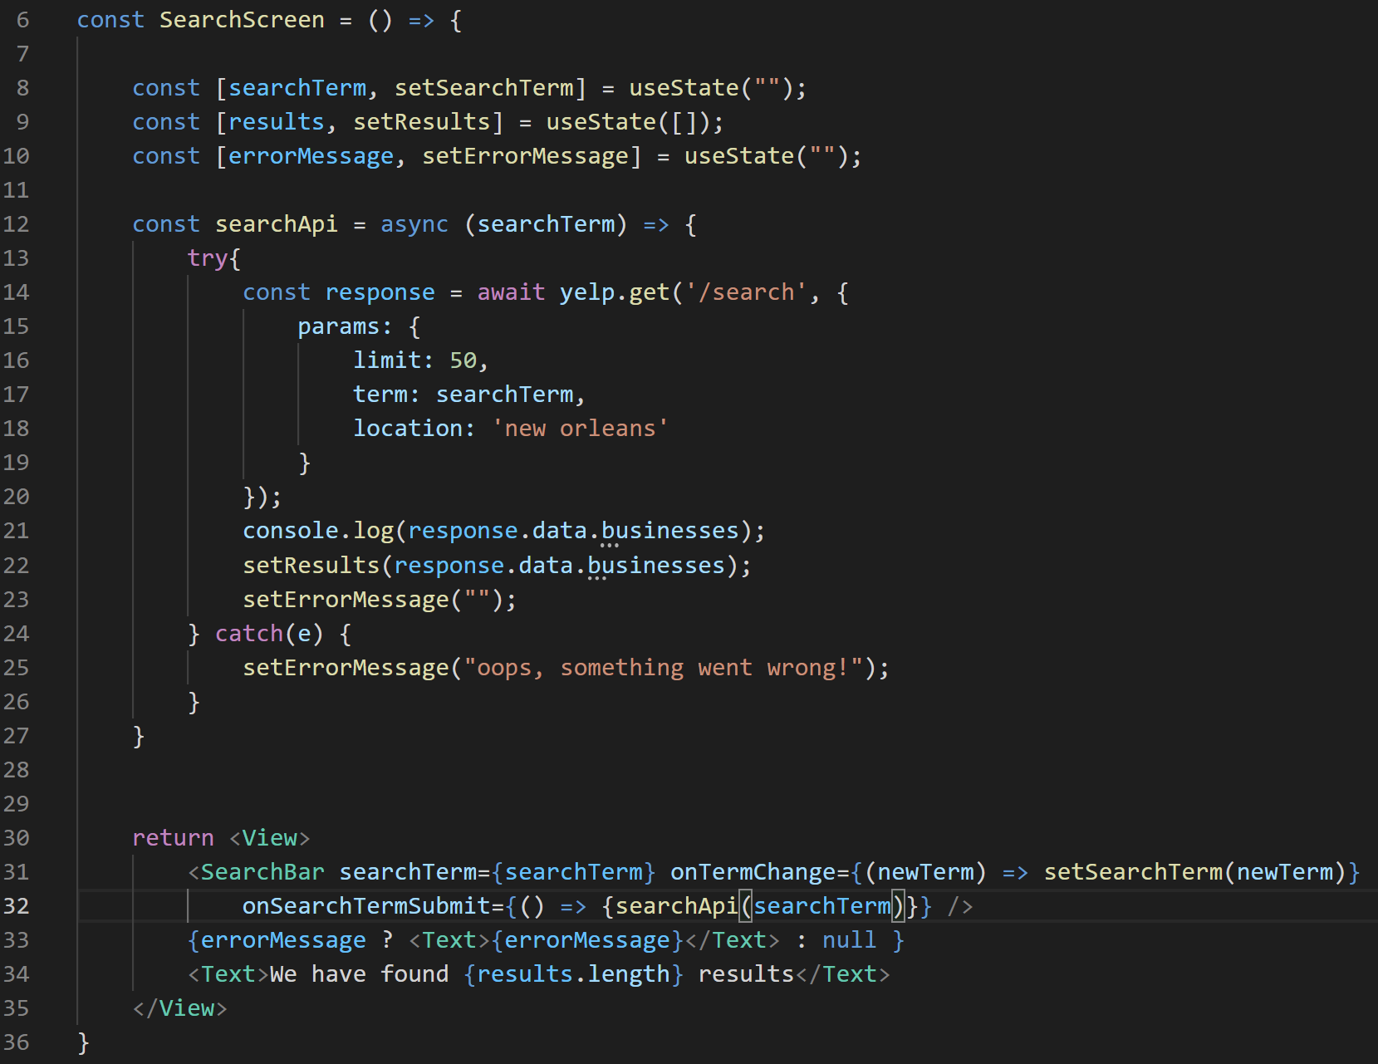
A First Search
So, we can parametrize this function, so that each time we call it, we pass in a different search term.
Making sure to then do so when we call it!

Slide 85
A First Search
So now when our component is first rendered on the screen, we can easily pass in whatever search term we please!

Slide 86
A First Search
So all of that stuff was good!
Now that we have it, what do you think the “bad way” we’re going to use it is?

Slide 87
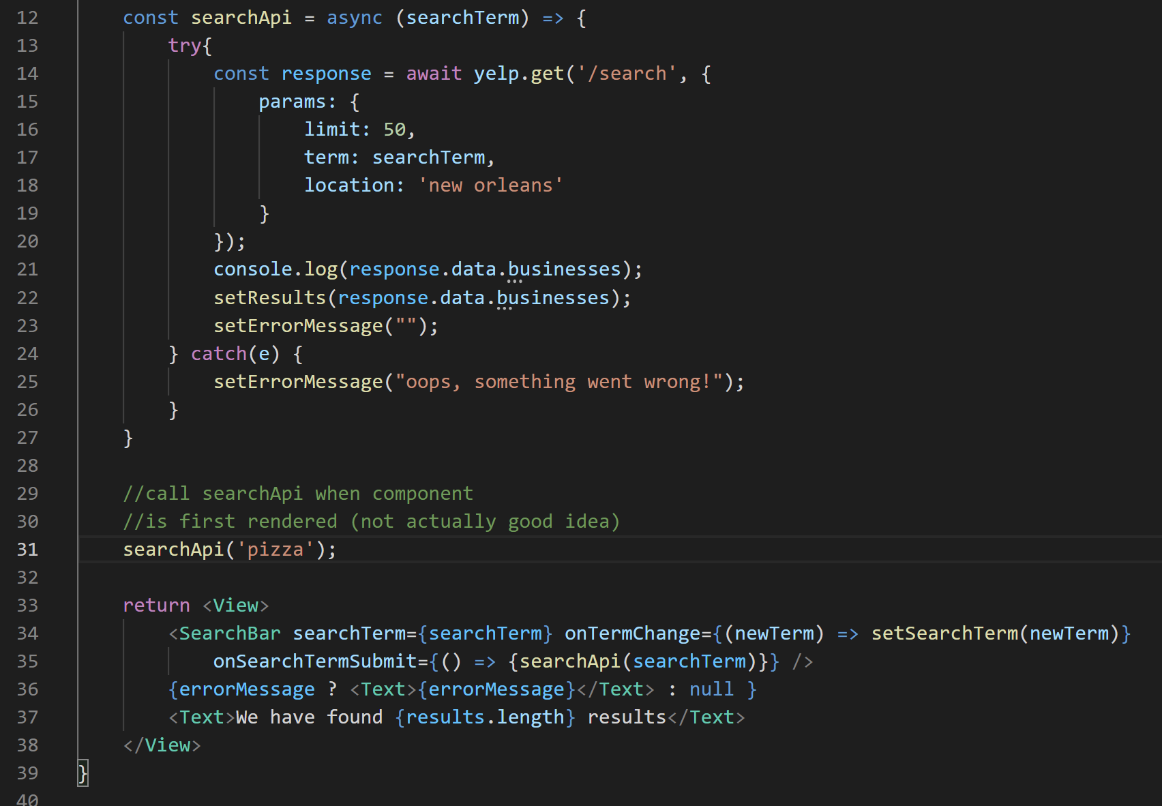

A First Search
I think the most intuitive way is to just, like, call this nice function when our component is first rendered.

Slide 88
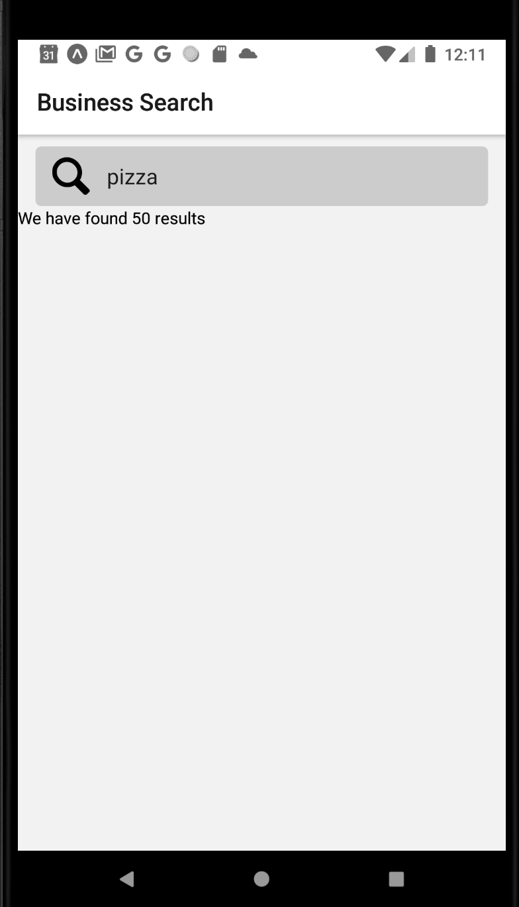
A First Search
And indeed, it LOOKS good!
When you open up the app, it loads the results right away!
BUT….

Slide 89
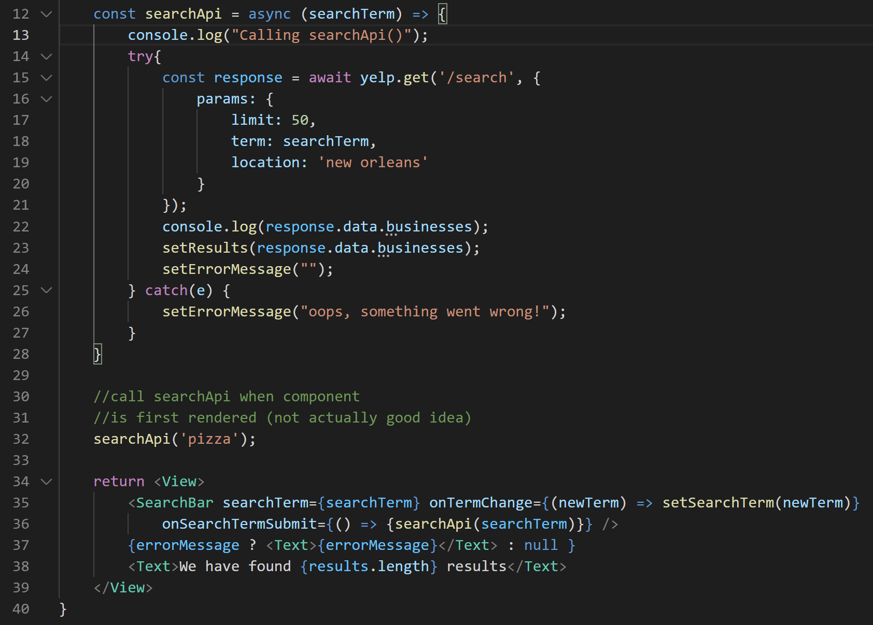

A First Search
If we added a console.log statement to the top of searchApi…

Slide 90
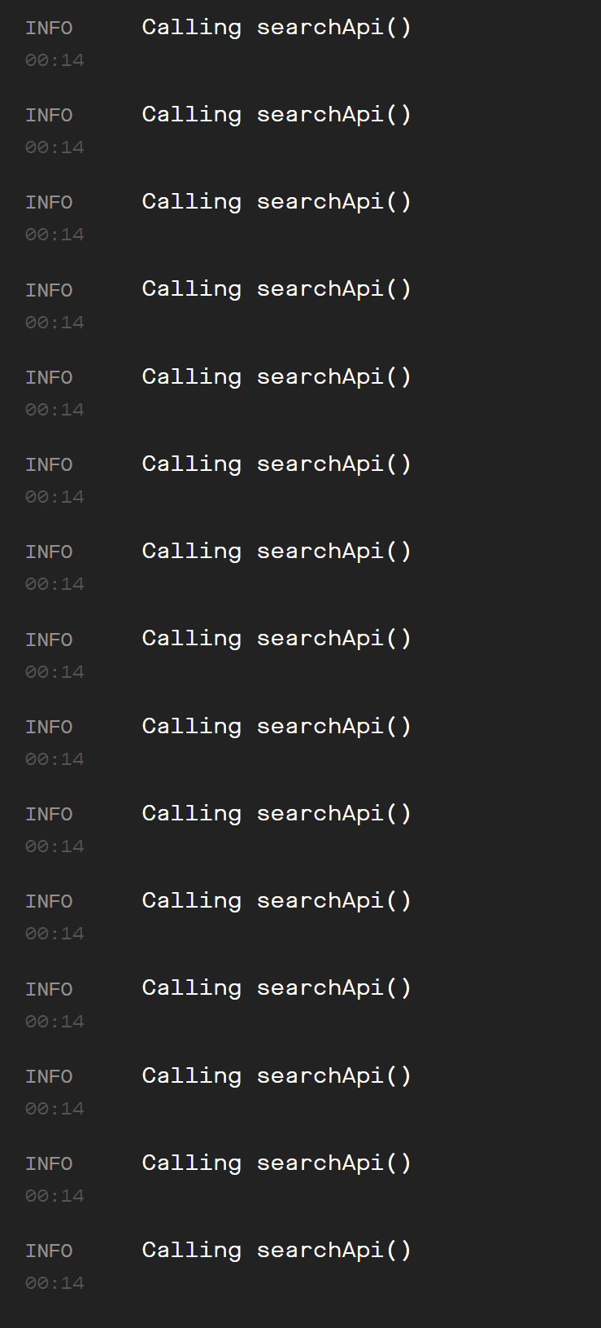
A First Search
You’ll see that we’re actually calling this method like, a million times.
So that’s a bad idea, and we can comment out/remove the bad call to searchApi().
Why was it so bad? What was going on there?

Slide 91
A First Search
We call searchApi() when the screen renders…
We update the state inside of searchApi()
Updating the state makes the screen rerender
rendering the screen makes us call searchApi()…

Slide 92
A First Search
We basically found ourselves caught in an infinite loop!

Slide 93
A First Search
So we need to do something clever to figure that out.
Which we will do!
At some point in the future!

